Slide 1


Family Law Webinar

Slide 2
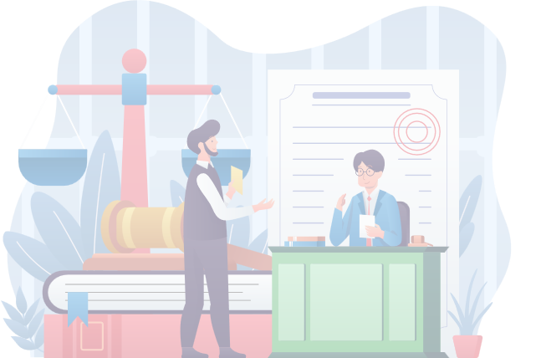

Legal Advice and Support
Our Services
Applying for Legal Aid

Slide 3


Legal Advice and Support
Immigration and Criminal Law Legal Clinic by Amado Claros
Family Law Legal Clinic by Jean Rene Dominique Kwilu

Slide 4

Family Law Legal Clinic

Slide 5

Through our Family Law legal clinic, you can receive personalized advice from our lawyers regarding:
  Divorce Petition
  Child Custody
  Child Support
  Spousal Support
  Domestic Abuse and many more

Slide 6
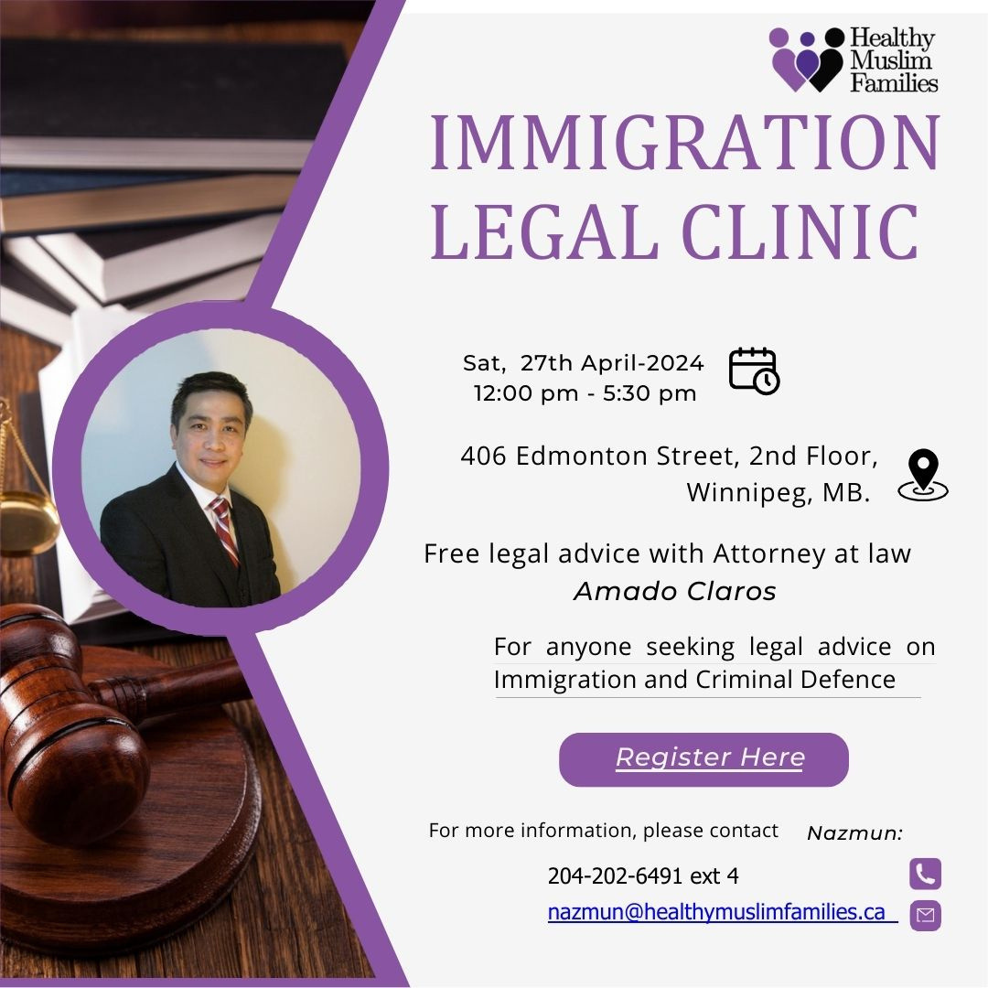
Immigration & Criminal Law Legal Clinic

Slide 7


How to Register to our legal clinics
  Register through our WhatsApp group advertisement or
  Reach out to us at nazmun@healthymuslimfamilies. com , or call us at 204 202 6491 ext 4

Slide 8
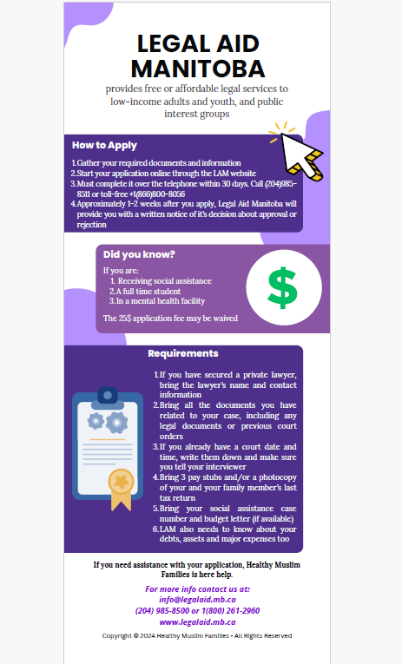
Legal Aid

Slide 9
  Prepare the required documents
  Pay the fee (if not waived)
  Apply online and complete the application with a phone-call to Legal Aid
  If you need assistance with applying for Legal Aid, reach out HMF at: nazmun@healthymuslimfamilies.ca / faadumo@healthymuslimfamilies.ca or call us at 204 202 6491 ext 4
Applying for Legal Aid

Slide 10

THANK YOU
for your attention !
Website: www.HealthyMuslimFamilies.ca Email: info@healthyMuslimFamilies.ca
Social Media: HealthyMuslimFamilies
Phone - (204) 202-6491

